Slide 1
hBN fitting
Yizhou Liu
Note: A1, xc1, A2, xc2, Lp, lambdafit, offset each represents, A,x_A,B, x_B, Lp, lambda_p, and ξ_0 in the function above.

Slide 2
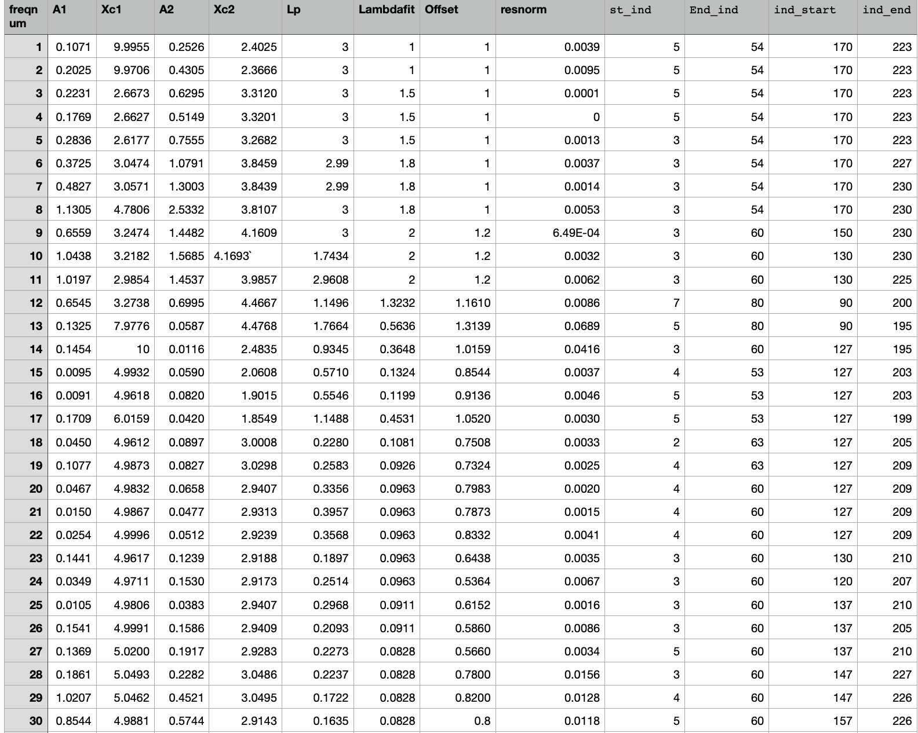
Data

Slide 3
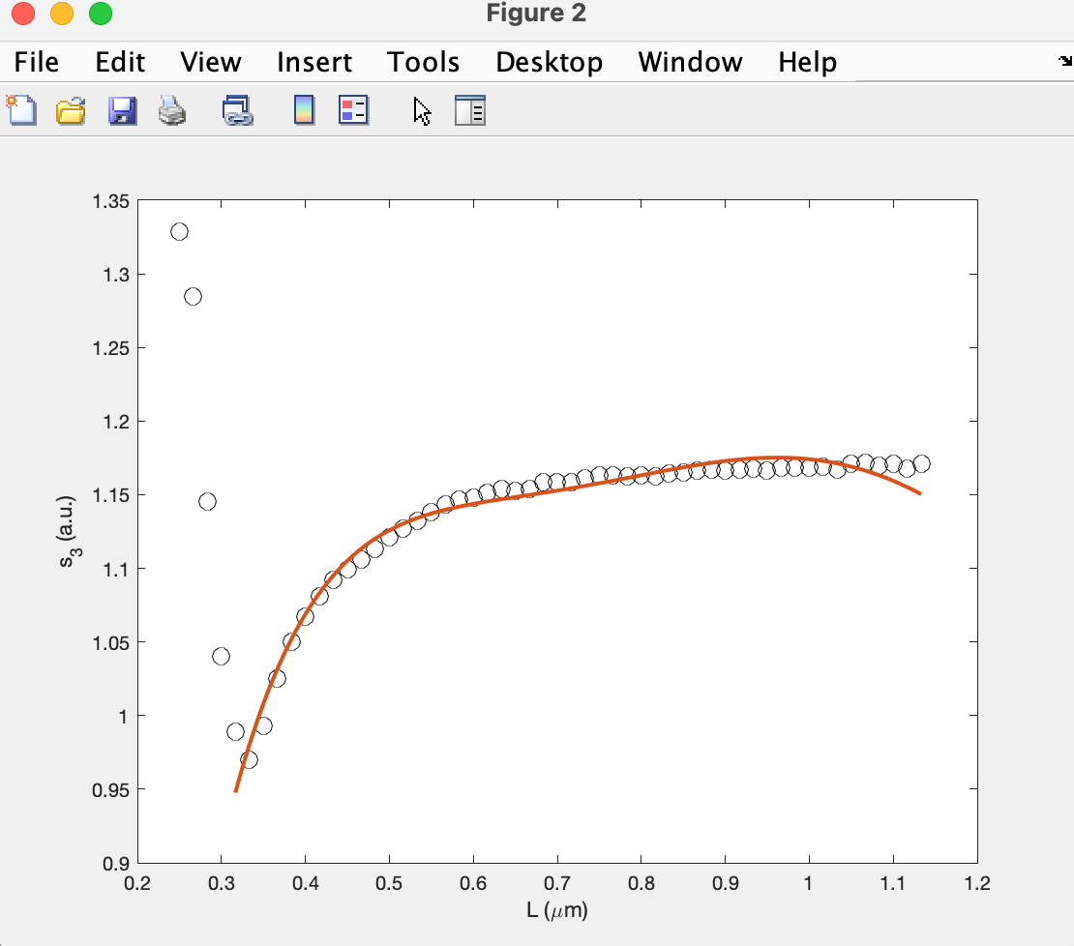
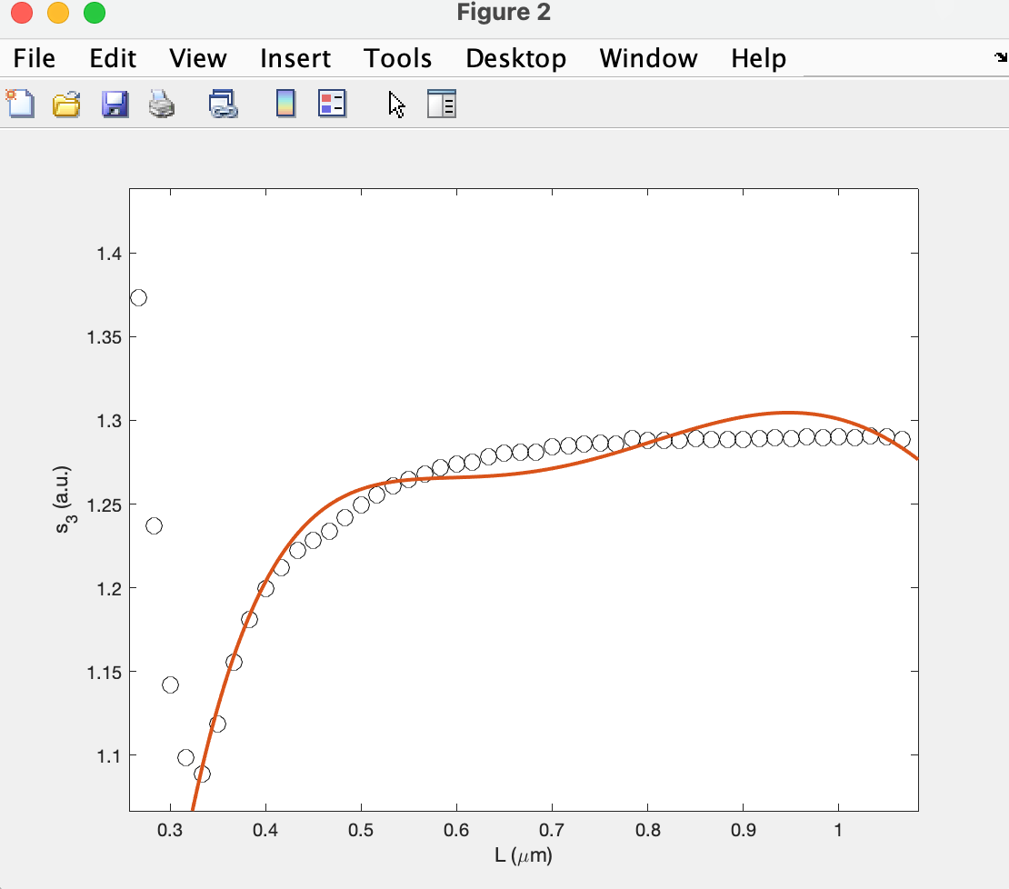
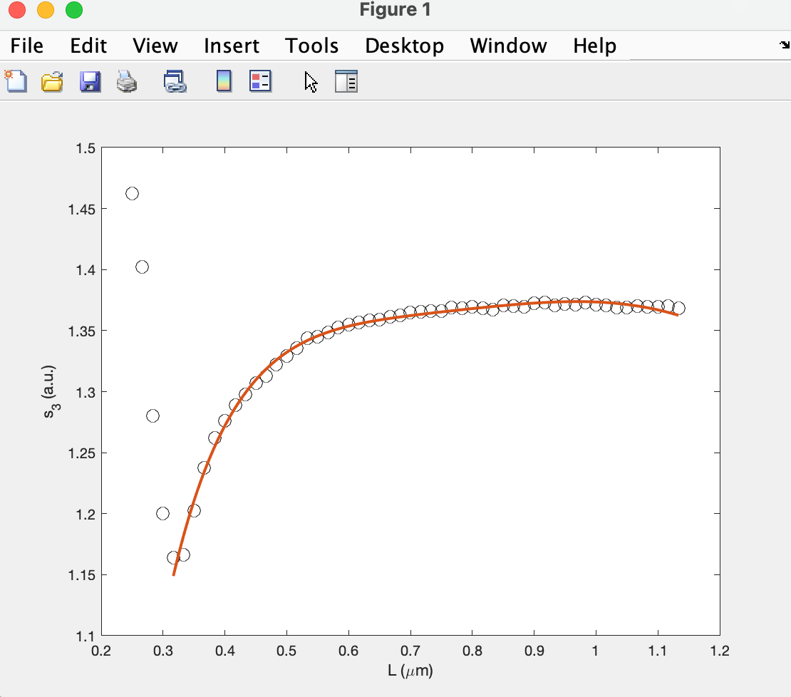
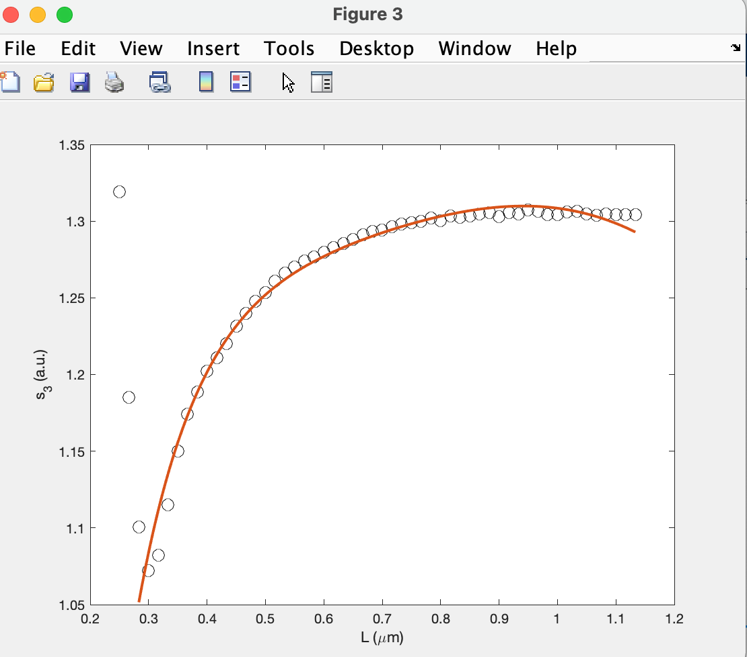
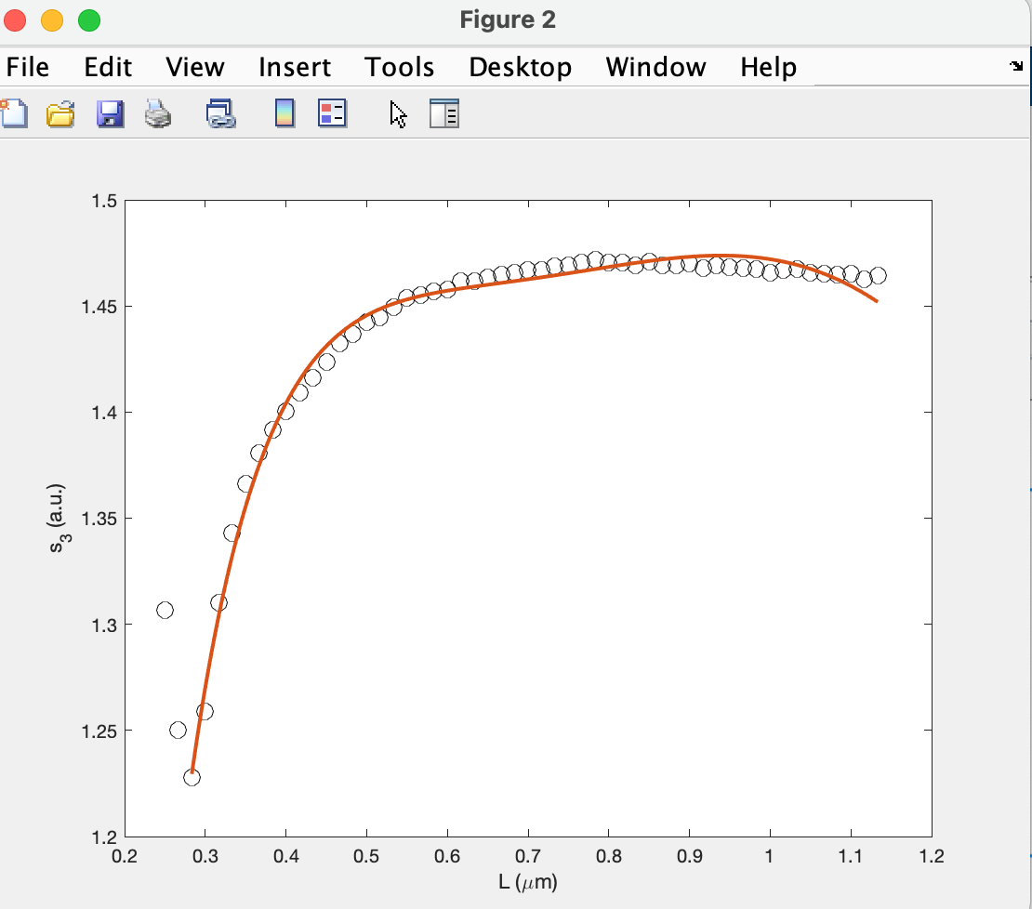
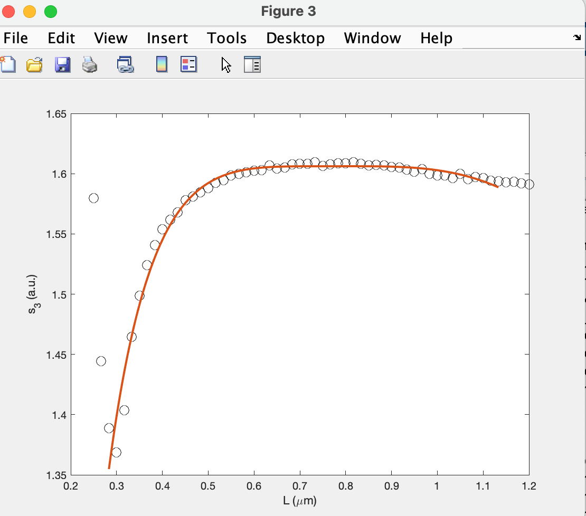
1370
1375
1380
1383
1385
1387

Slide 4
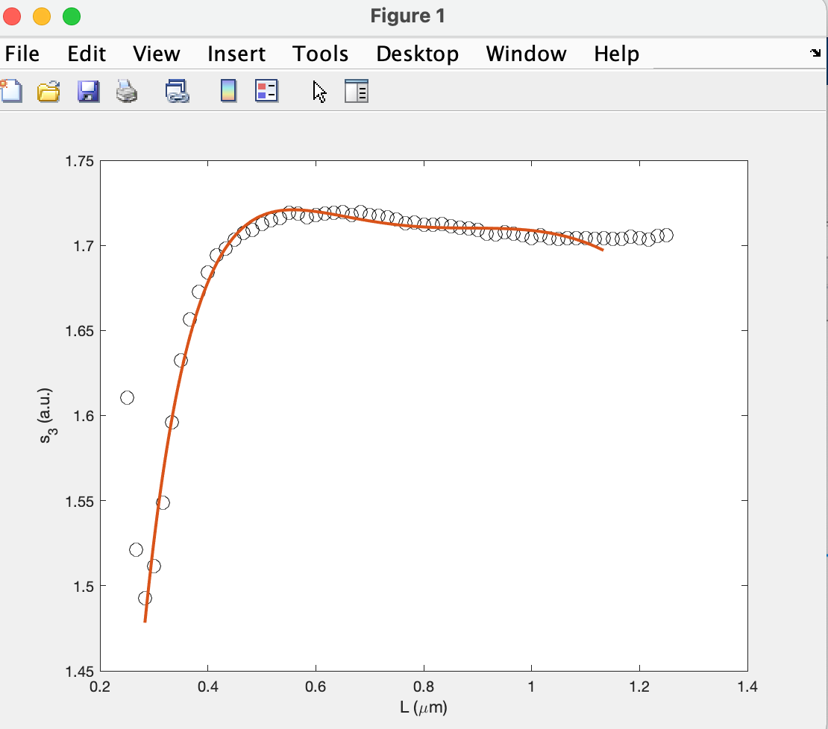
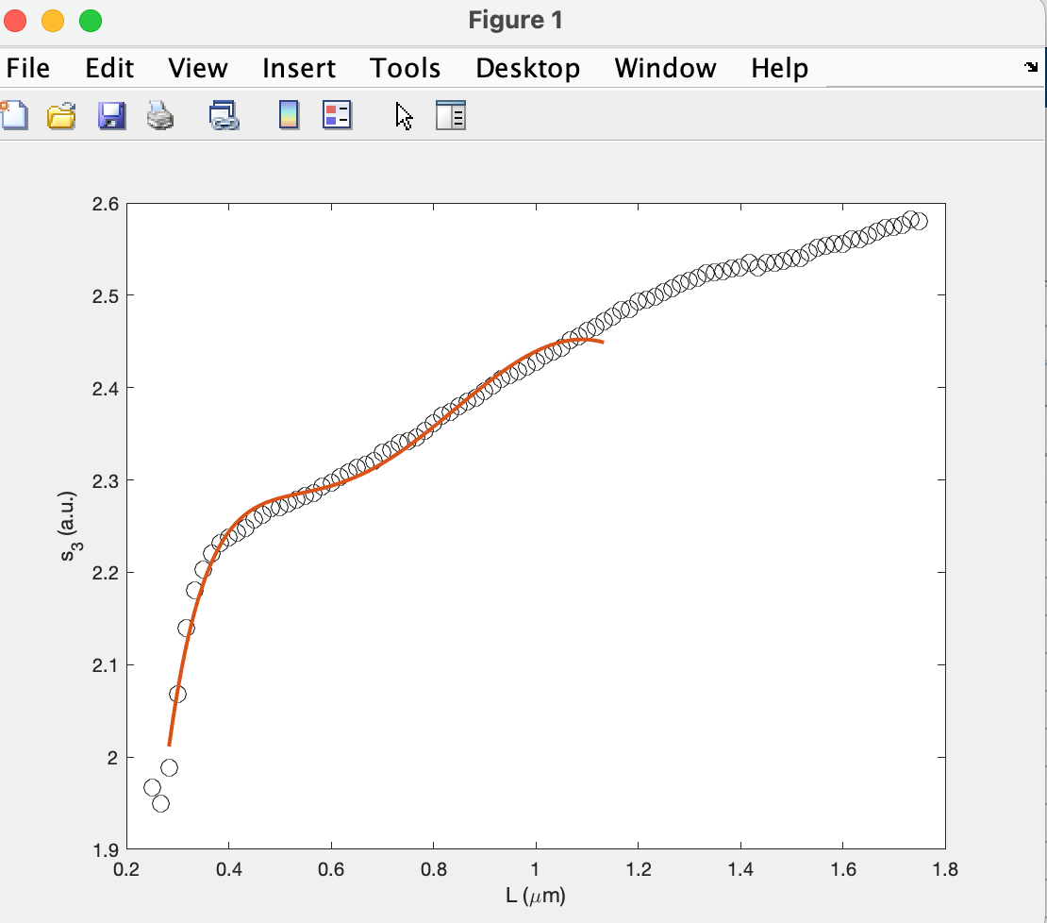
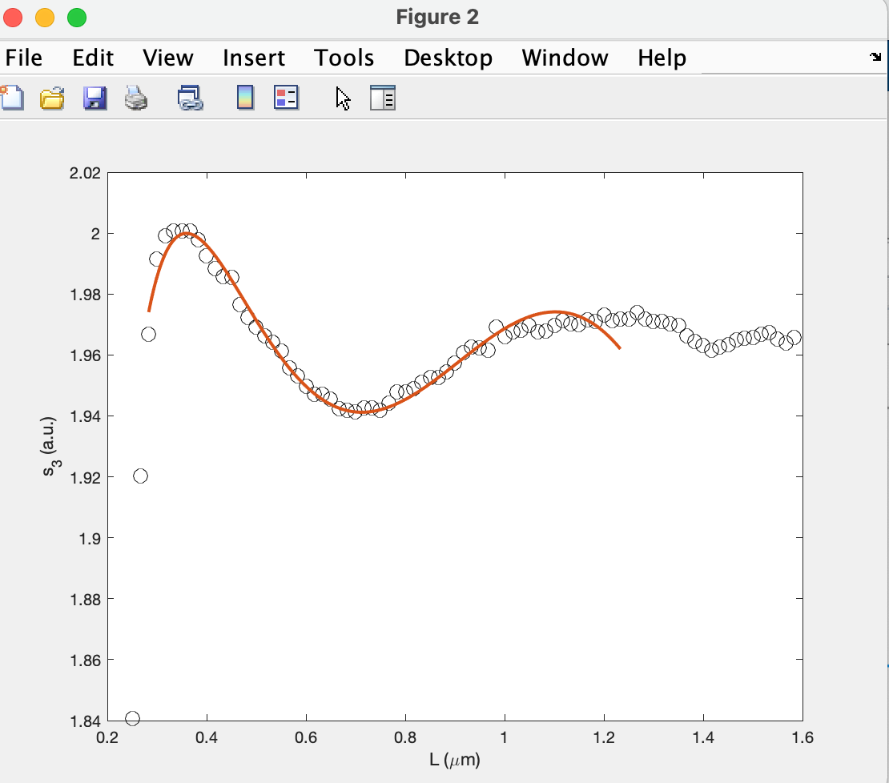
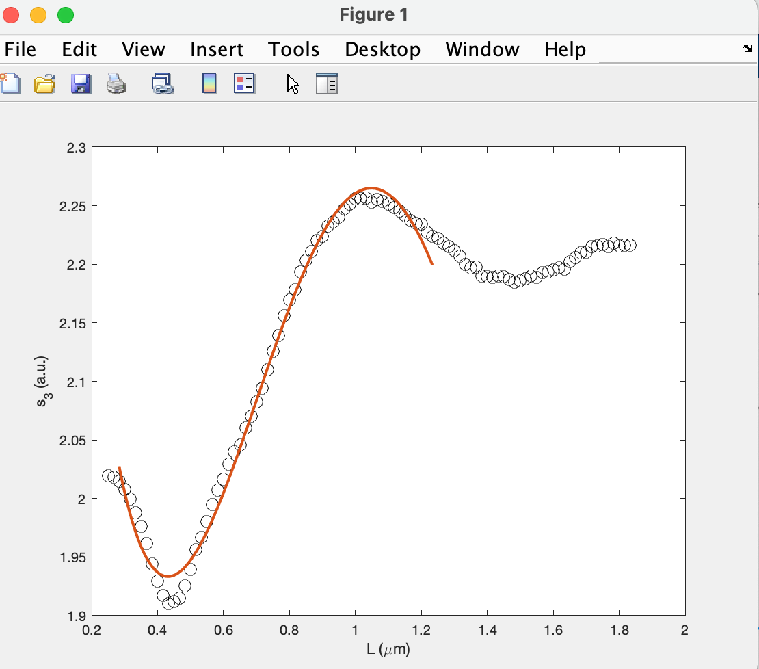
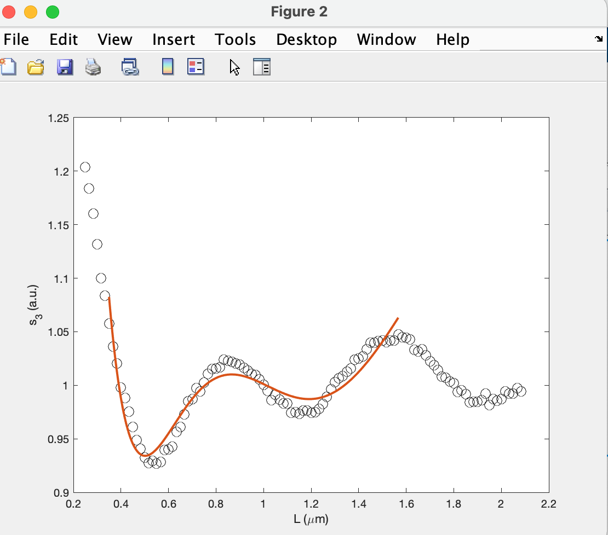
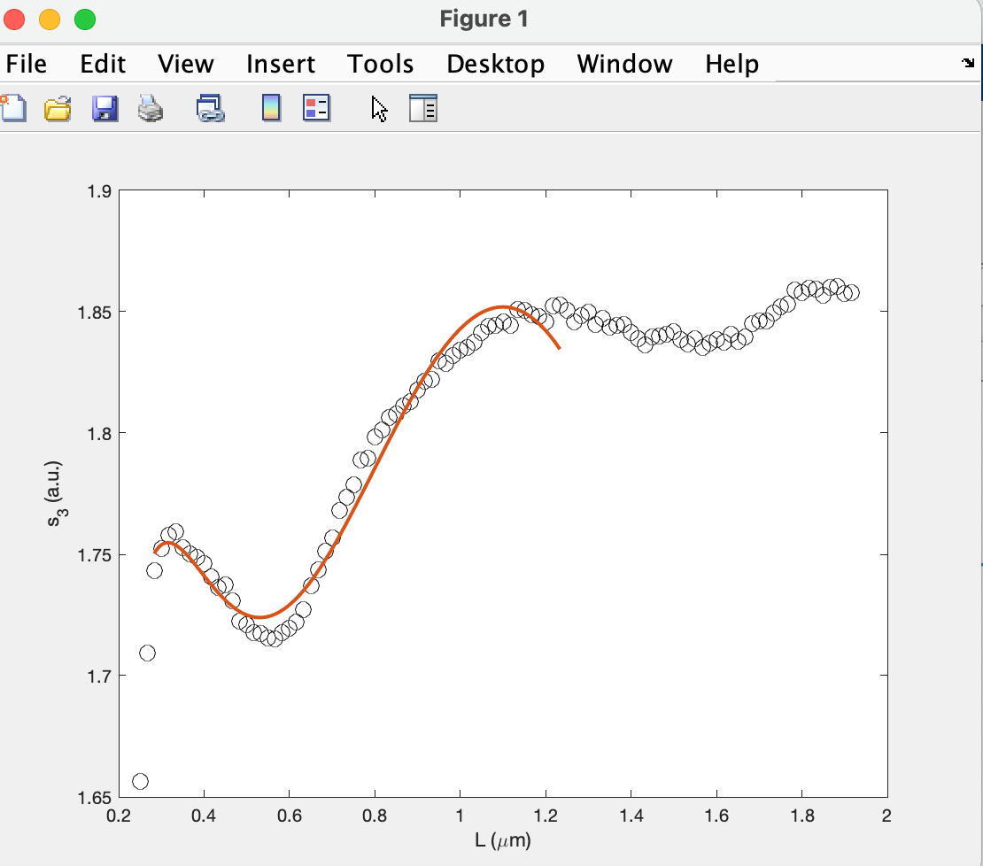
1390
1392
1395
1410
1387
1400

Slide 5
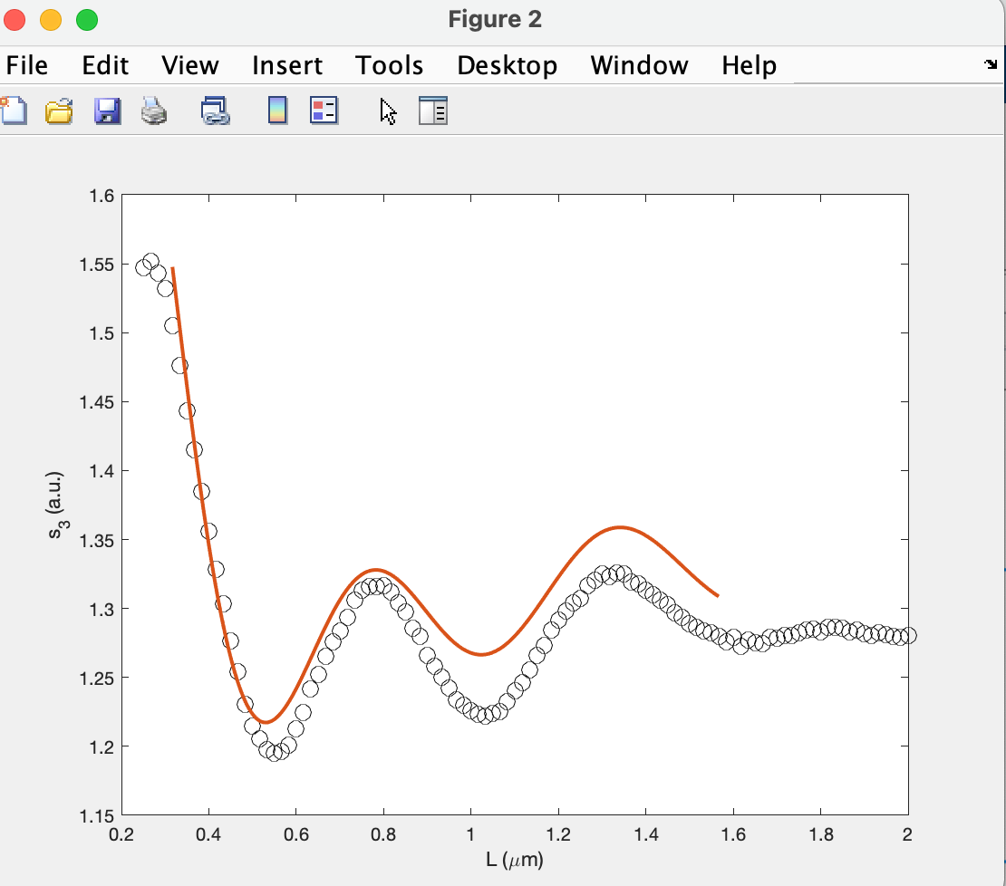
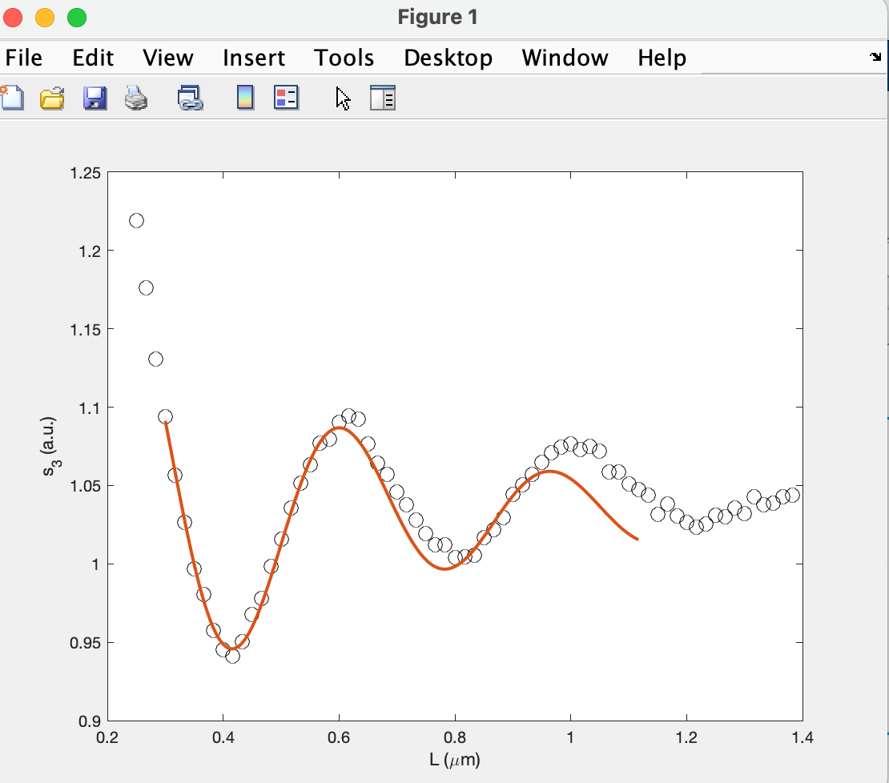
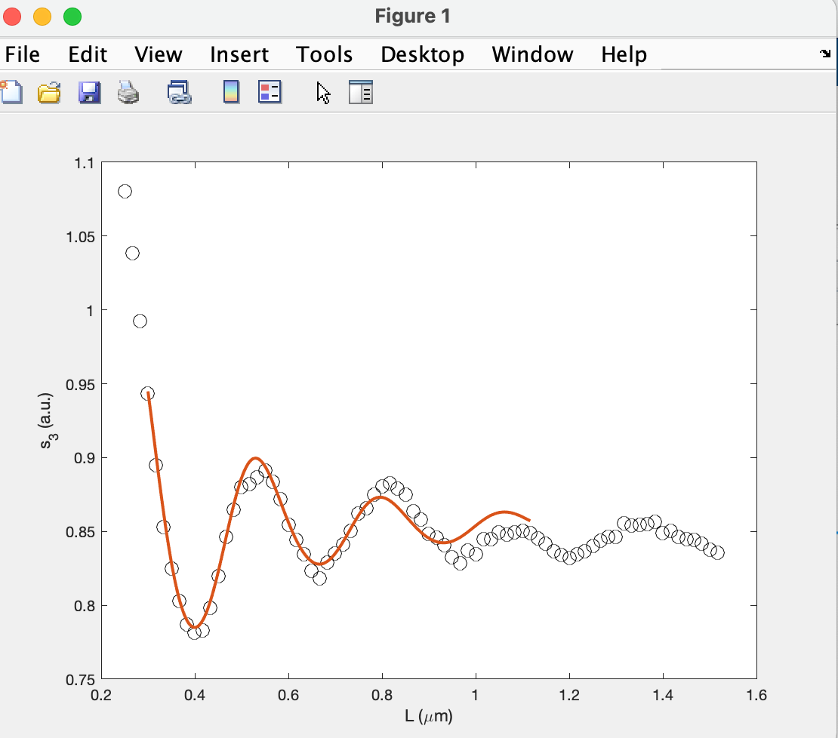
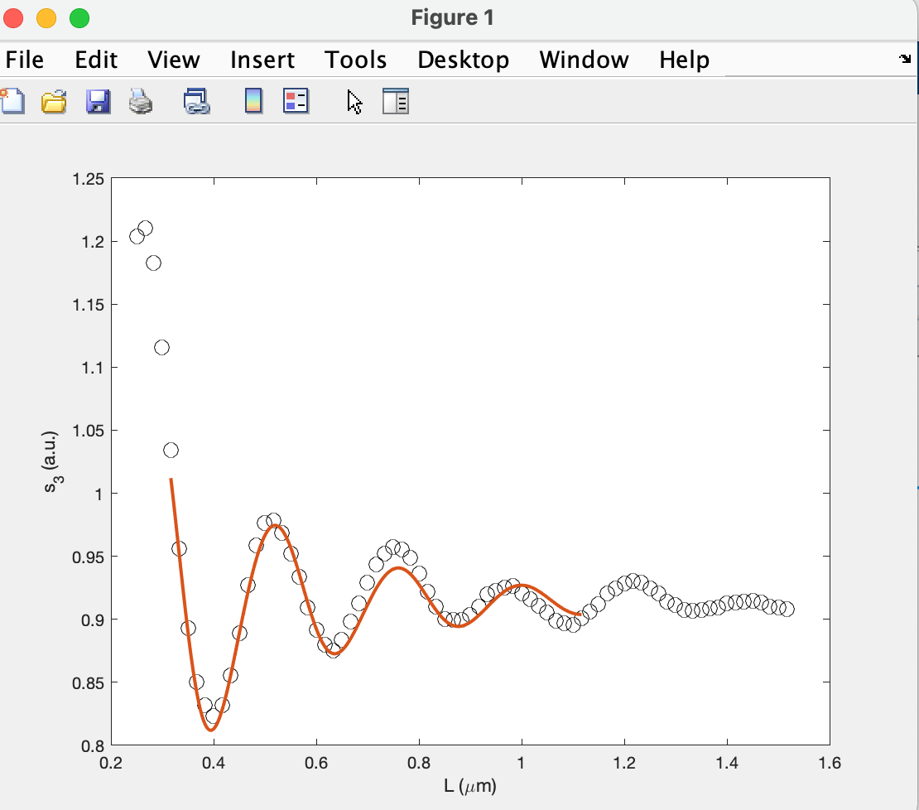
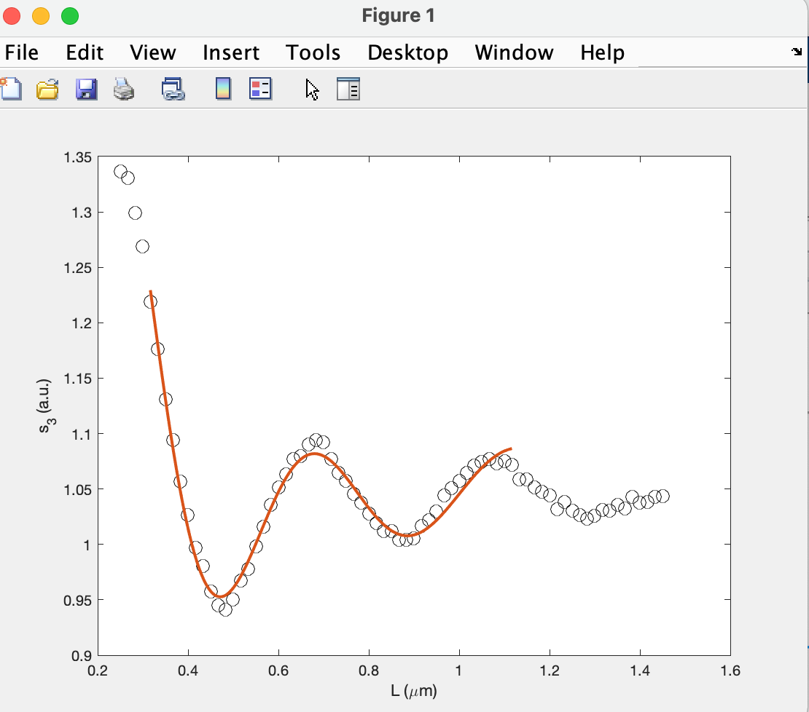
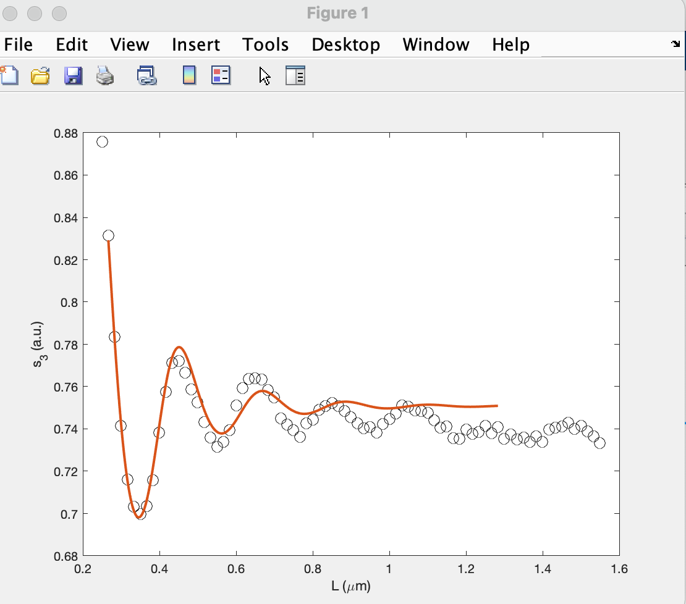
1420
1430
1449
1460
1465
1470

Slide 6
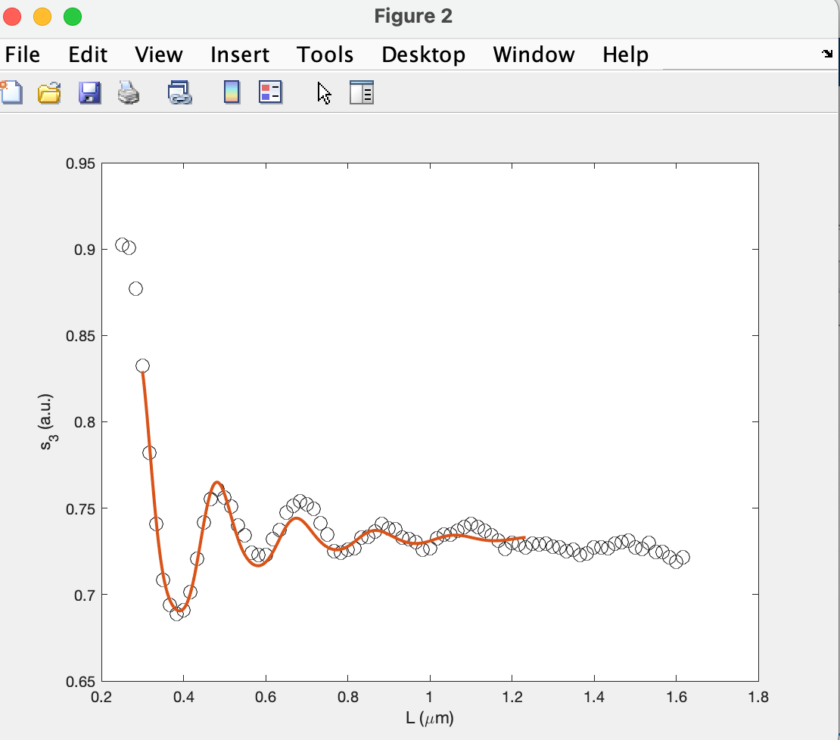
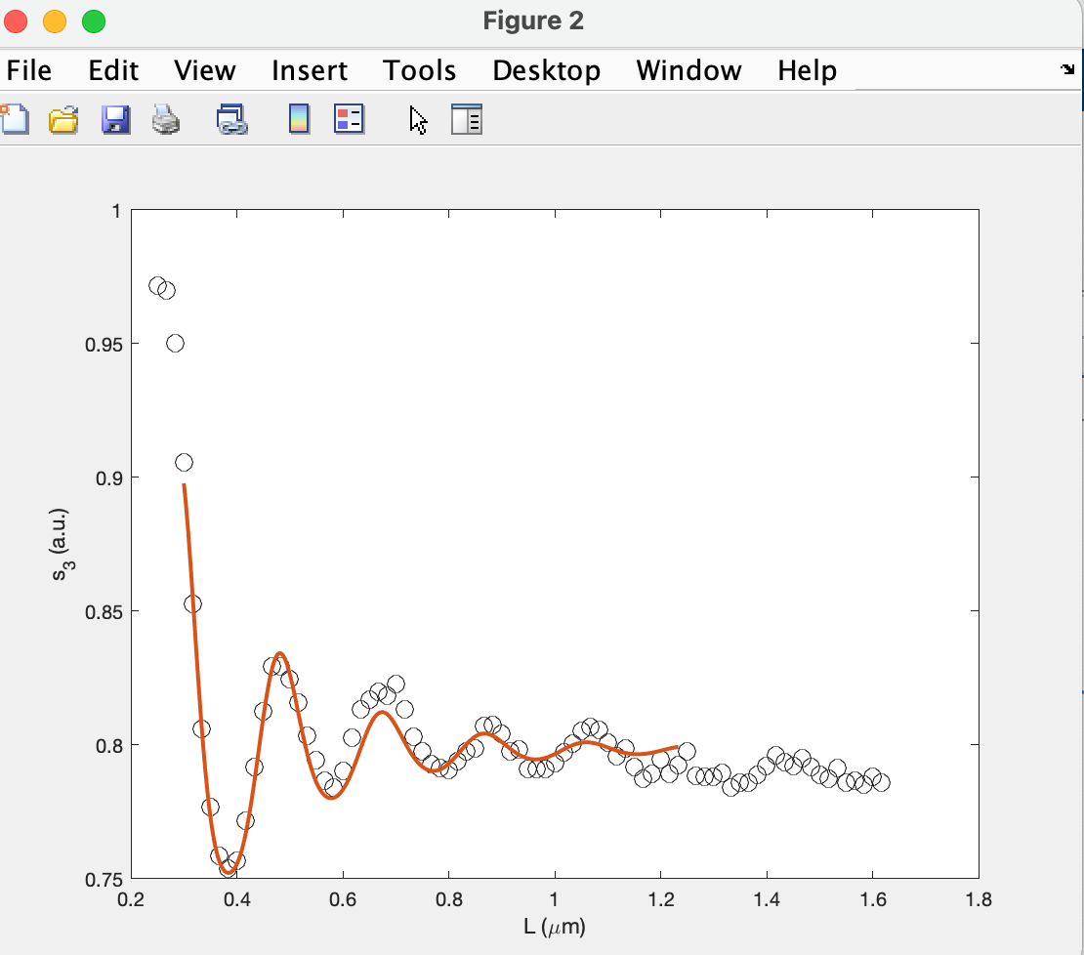
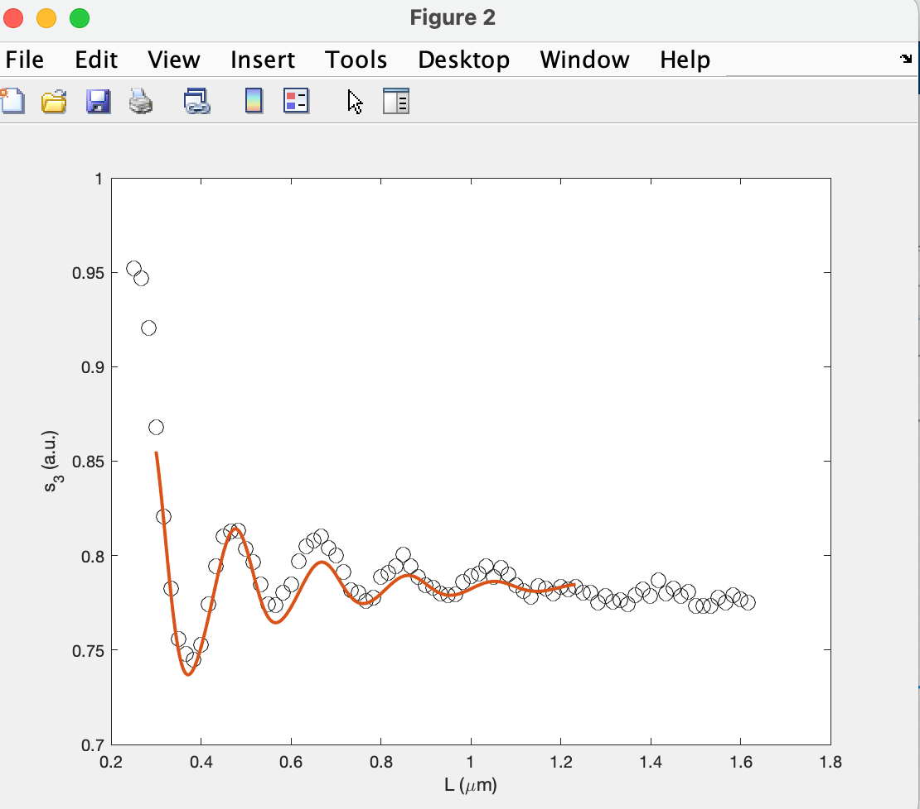
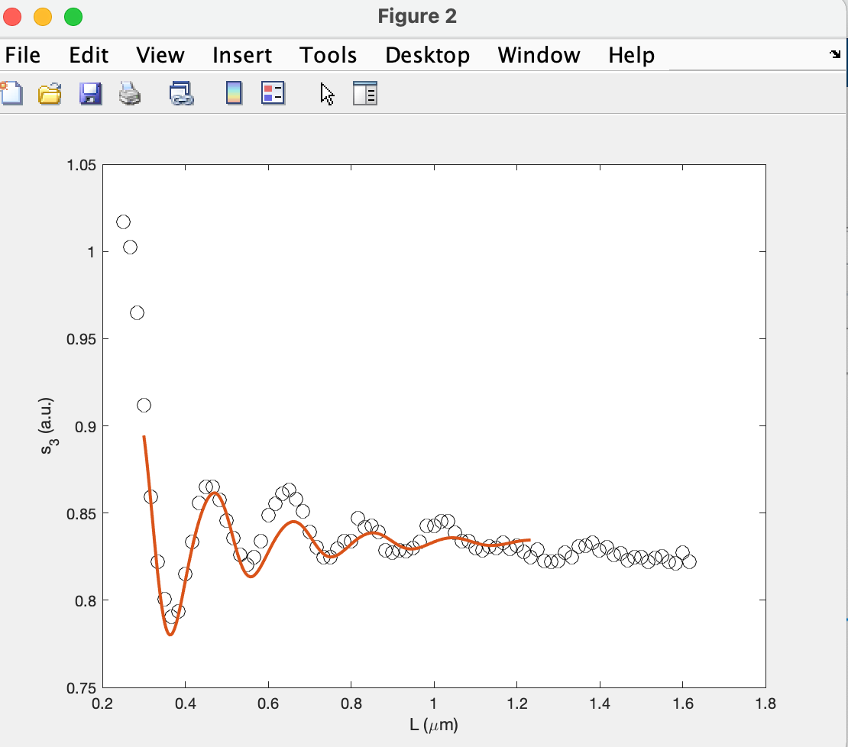
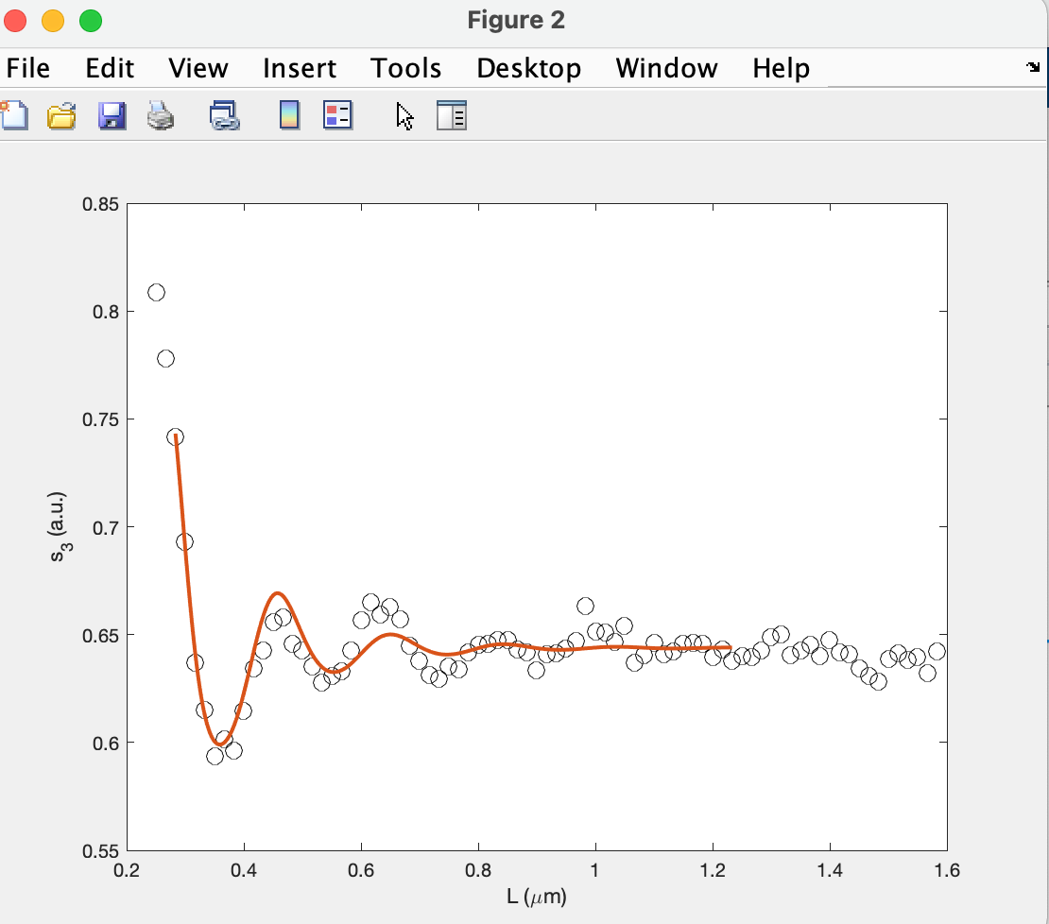
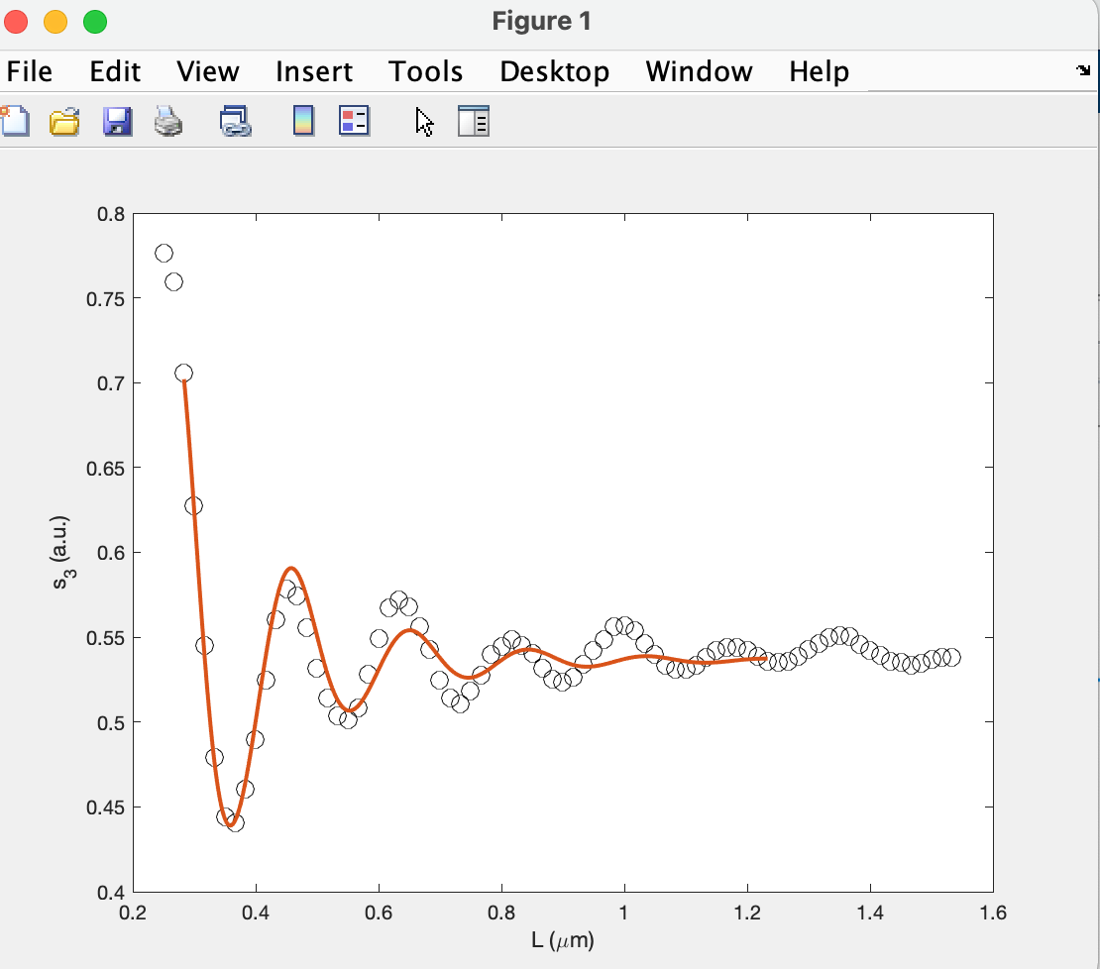
1471
1473
1475
1477
1479
1480

Slide 7
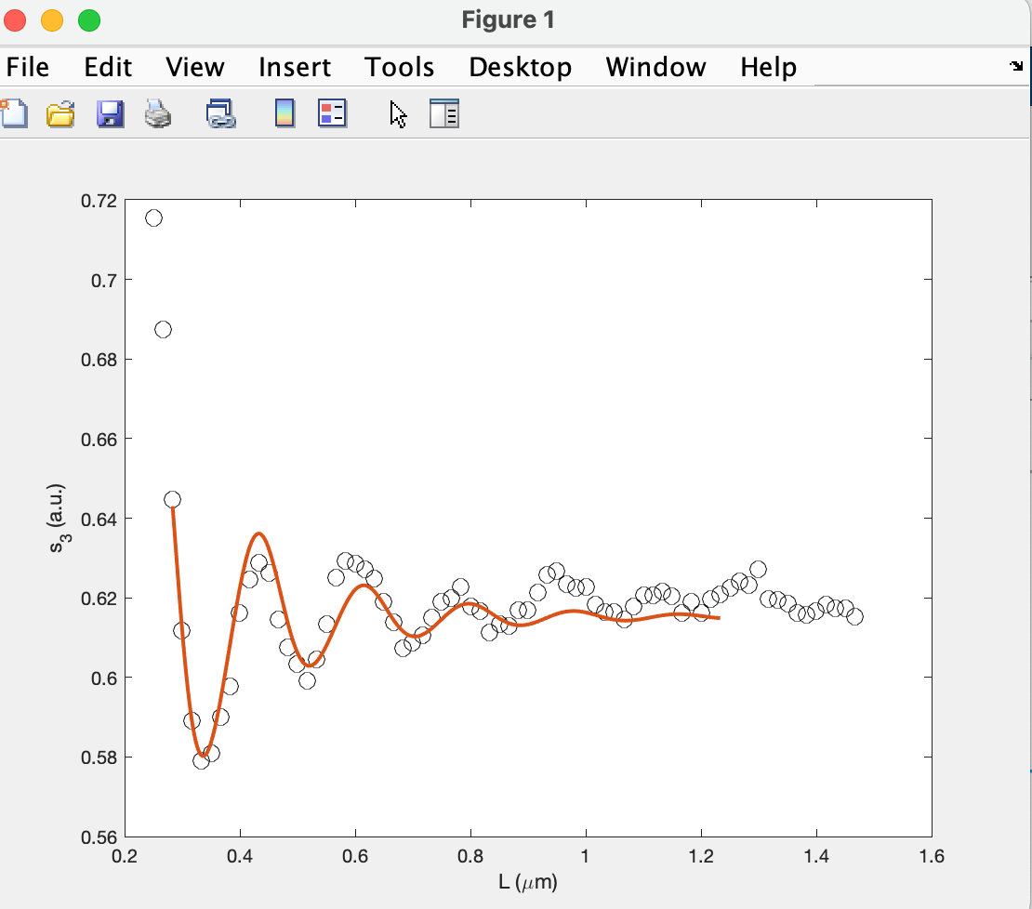
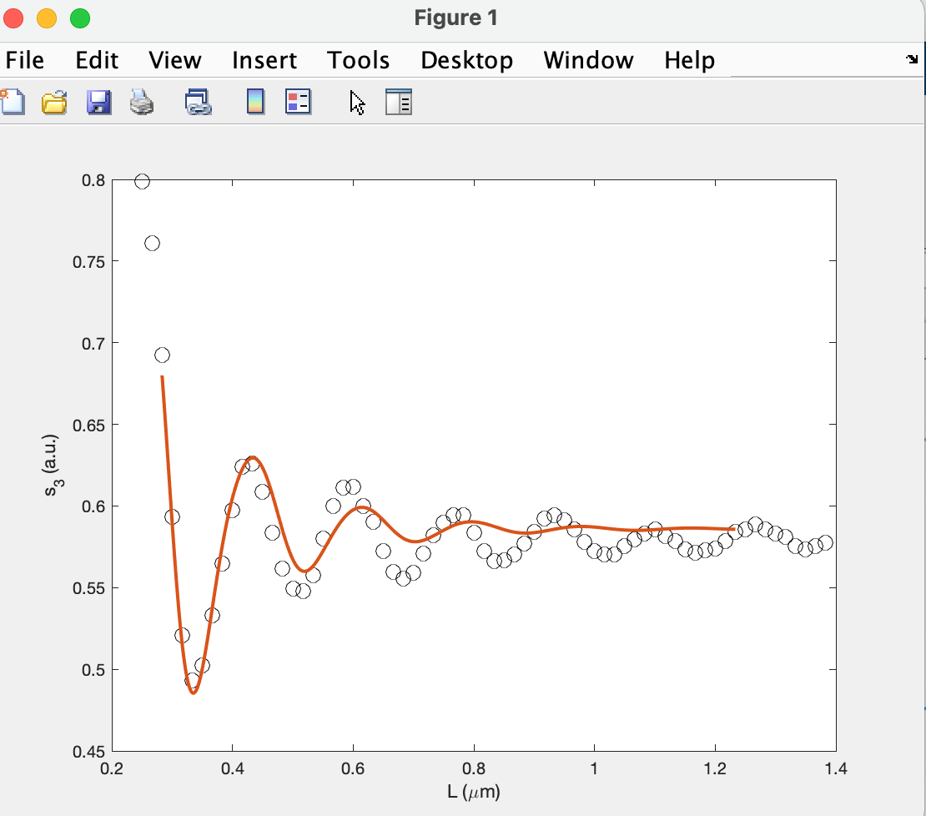
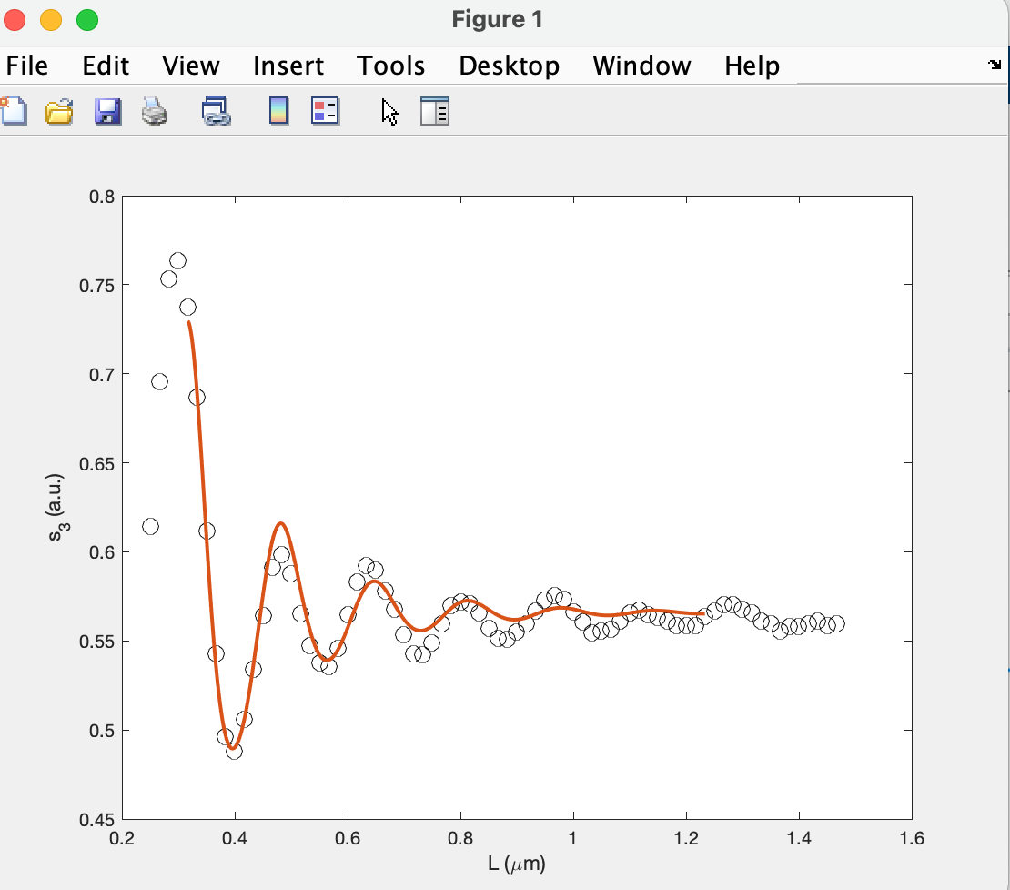
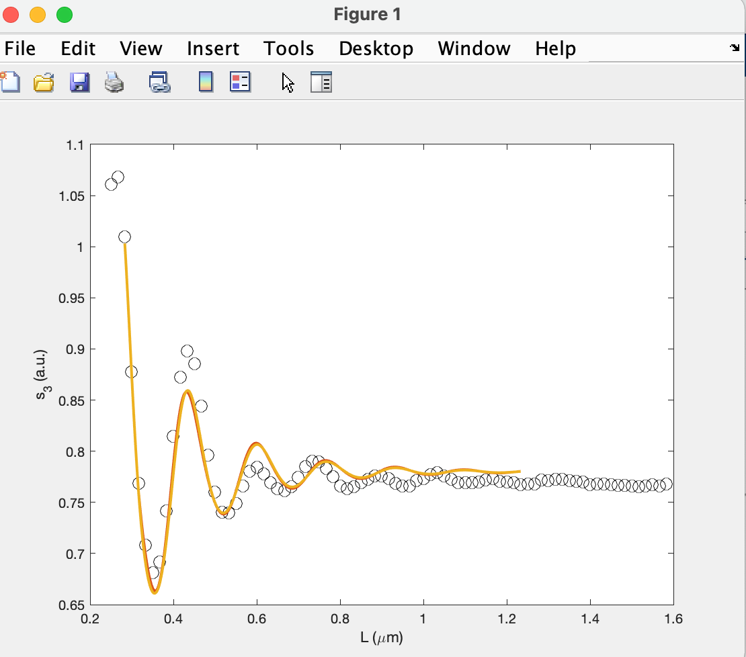
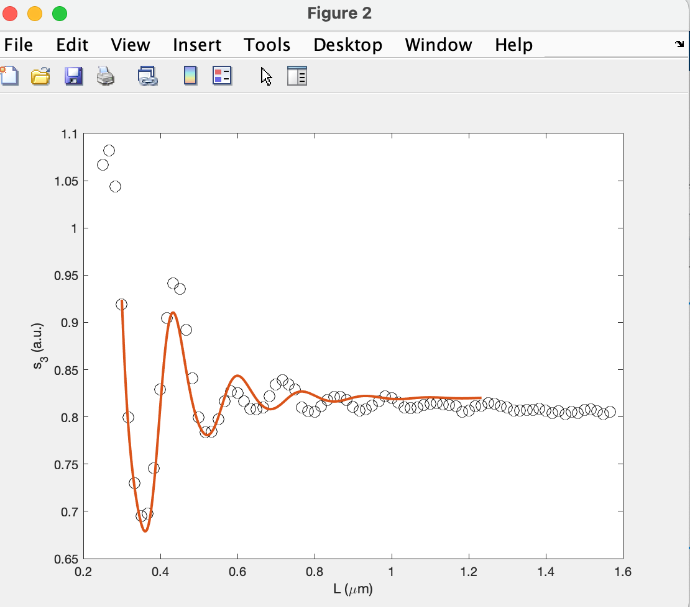
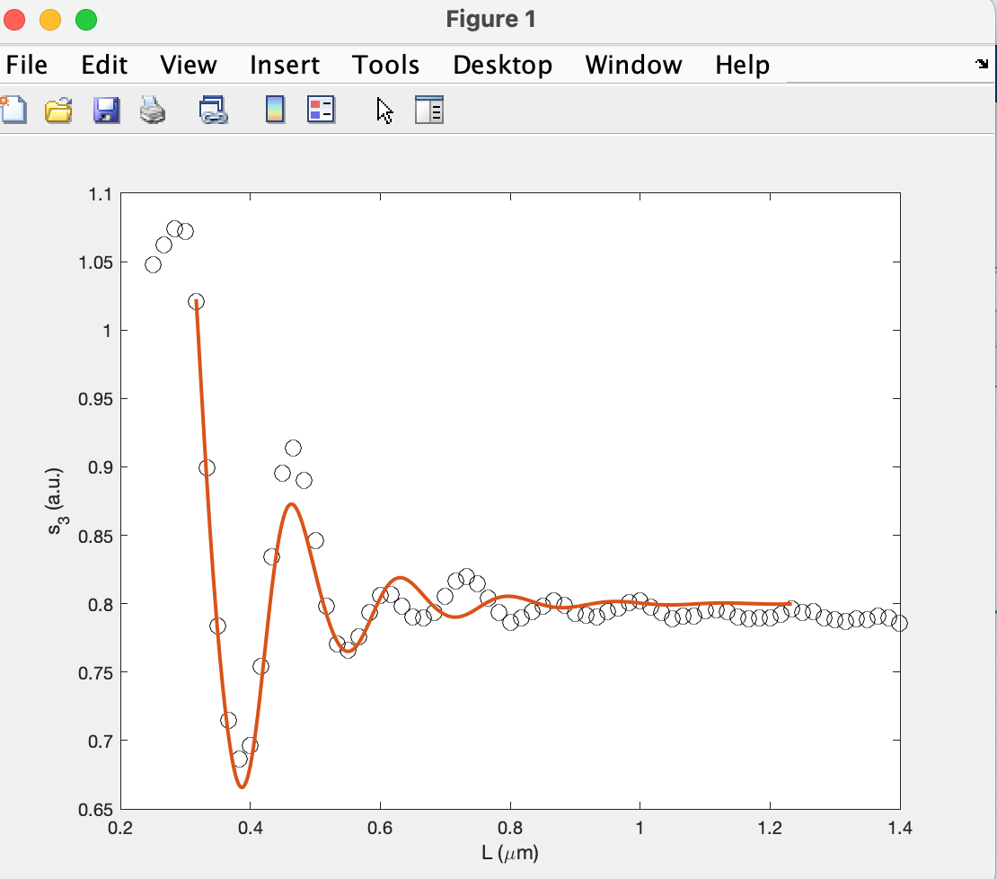
1489
1483
1485
1500
1505
1509.5

Slide 8
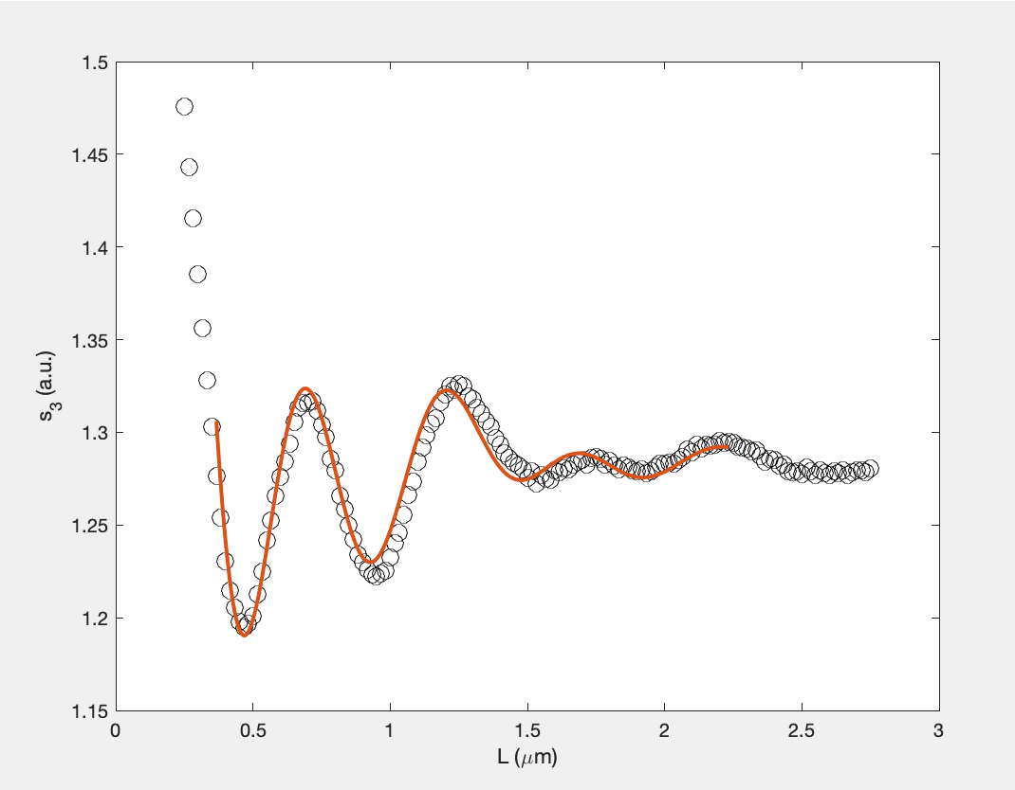
Update 1 frequency 1420
A1: 0.1746
xc1: 1.0861
A2: 0.0454
xc2: 1.0388
Lp: 1.2992
lambda fit: 0.5
offset: 1.285
Residual: 0. 0071
Raw data selection: [40,190]
Reversing selection: [8,120]

Slide 9
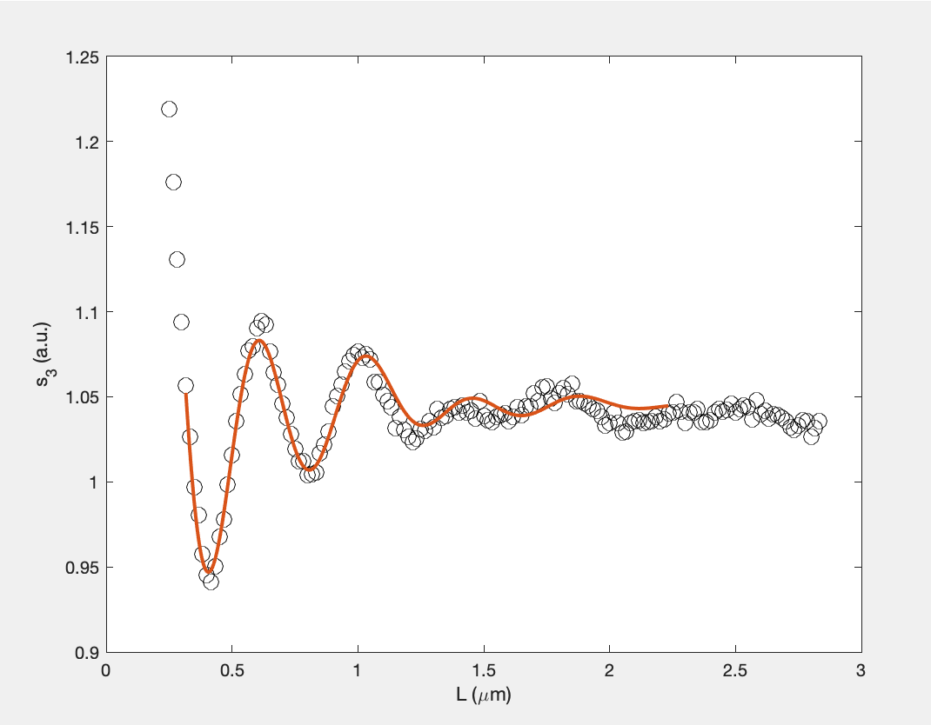
Update 1 frequency 1430
A1: 0.1394
xc1: 0.9365
A2: 0.0222
xc2: 0.8530
Lp: 1.1001
lambda fit: 0.4235
offset: 1.045
Residual: 0. 0061
Raw data selection: [40,195]
Reversing selection: [5,120]

Slide 10
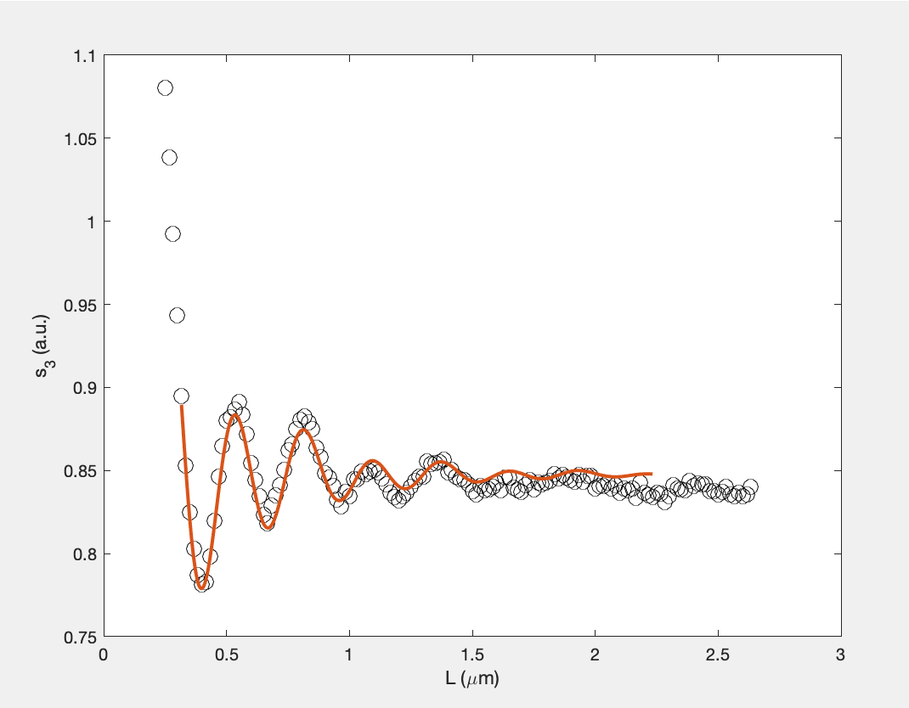
Update 1 frequency
1449
A1: 0.0913
xc1: 1.0279
A2: 0.0087
xc2: 0.6793
Lp: 1.0720
lambda fit: 0.2793
offset: 0.8475
Residual: 0.0048
Raw data selection: [60,203]
Reversing selection: [5,120]

Slide 11
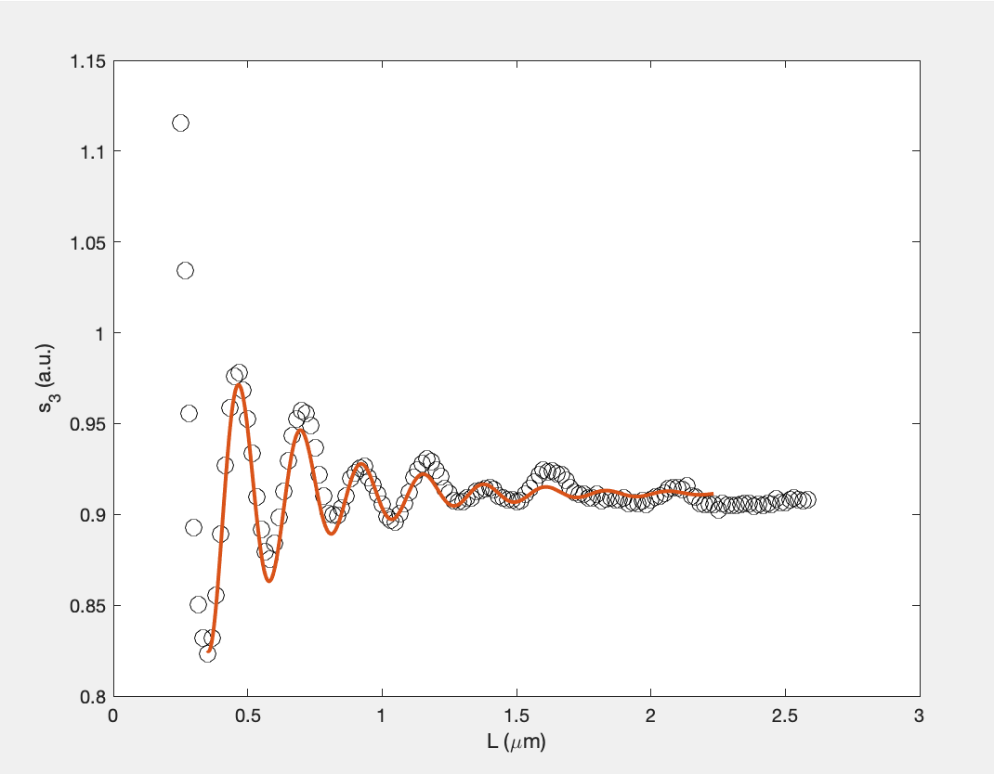
Update 1 frequency
1460
A1: 0.1158
xc1: 1.0976
A2: 0.0045
xc2: 1.0943
Lp: 0.9644
lambda fit: 0.2279
offset: 0.9115
Residual: 0.0051
Raw data selection: [60,200]
Reversing selection: [7,120]

Slide 12
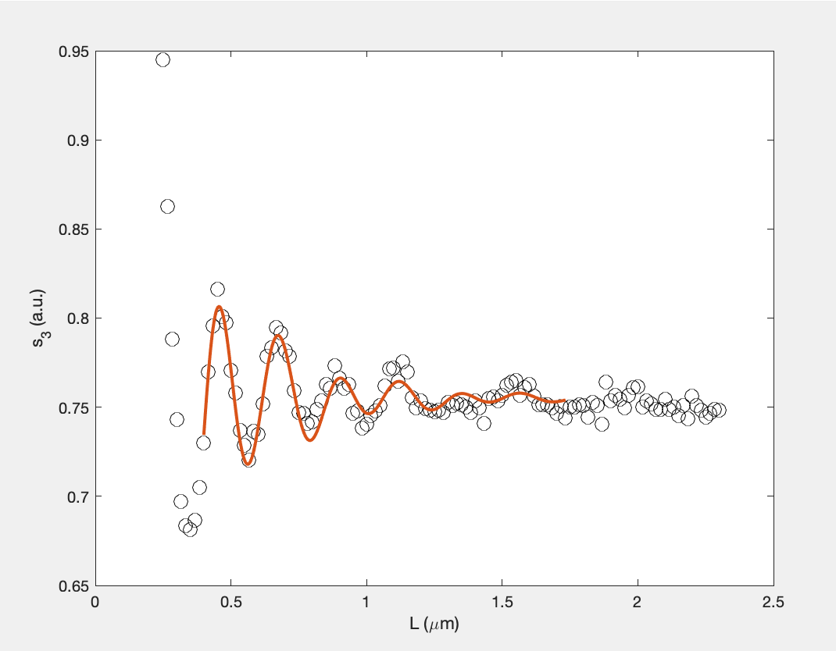
Update 1 frequency
1465
A1: 0.1324
xc1: 1.0711
A2: 0.0112
xc2: 0.9675
Lp: 0.7977
lambda fit: 0.2231
offset: 0.7550
Residual: 0.0030
Raw data selection: [80,203]
Reversing selection: [10,90]

Slide 13
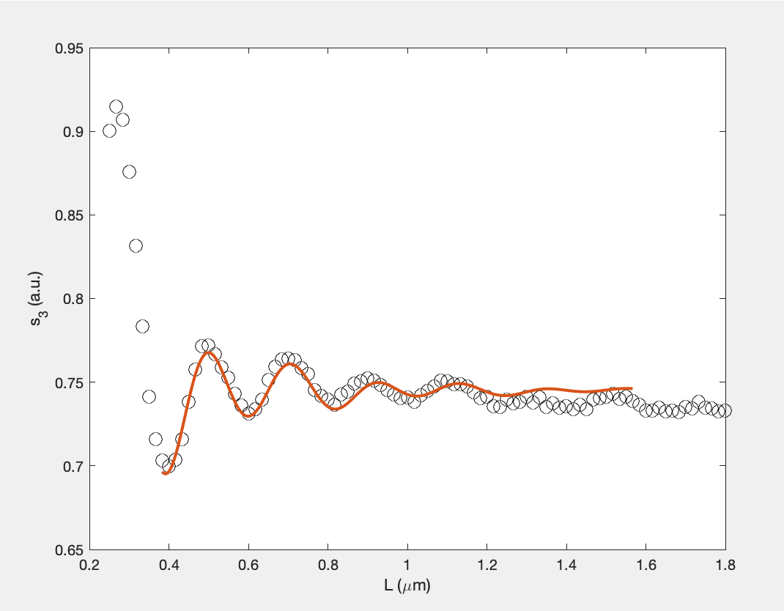
Update 1 frequency
1470
A1: 0.0777
xc1: 1.0852
A2: 0.0073
xc2: 1.4025
Lp: 0.7260
lambda fit: 0.2128
offset: 0.7450
Residual: 0.0019
Raw data selection: [115,208]
Reversing selection: [9,80]

